Slide 2

Applied Algorithm Lab
Count #solutions to an integer linear equation

Slide 3
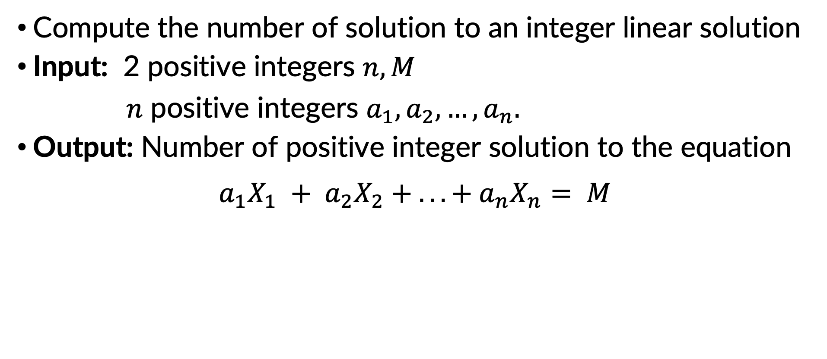
Count #solutions to an integer linear equation
Compute the number of solution to an integer linear solution
Input: 2 positive integers $n, M$
$n$ positive integers $a_{1}, a_{2}, …, a_{n}.$
Output: Number of positive integer solution to the equation
$$a_{1}X_{1} + a_{2}X_{2} + . . . + a_{n}X_{n}= M$$

Slide 4
Count #solutions to an integer linear equation
Example
stdin | stdout
3 5 1 1 1 | 6 Explain: (1,1,3), (1,2,2), (1,3,1), (2,1,2), (2,2,1), (3,1,1)

Slide 5
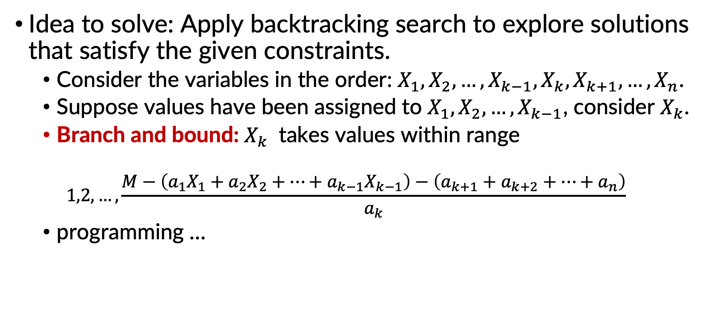
Count #solutions to an integer linear equation
Idea to solve: Apply backtracking search to explore solutions that satisfy the given constraints.
Consider the variables in the order: $X_{1}, X_{2}, …, X_{k−1}, X_{k}, X_{k+1}, …, X_{n}$.
Suppose values have been assigned to $X_{1}, X_{2}, …, X_{k−1}$, consider $X_{k}$.
Branch and bound: $X_{k}$ takes values within range
$$1,2,…, \frac{M−\left(a_{1}X_{1}+a_{2}X_{2}+⋯+a_{k−1}X_{k−1}\right)−\left(a_{k+1}+a_{k+2}+⋯+a_{n}\right)}{a_{k}}$$
programming …

Slide 6
THANK YOU !

